Slide 1

Principal Component Analysis (PCA)

Slide 2
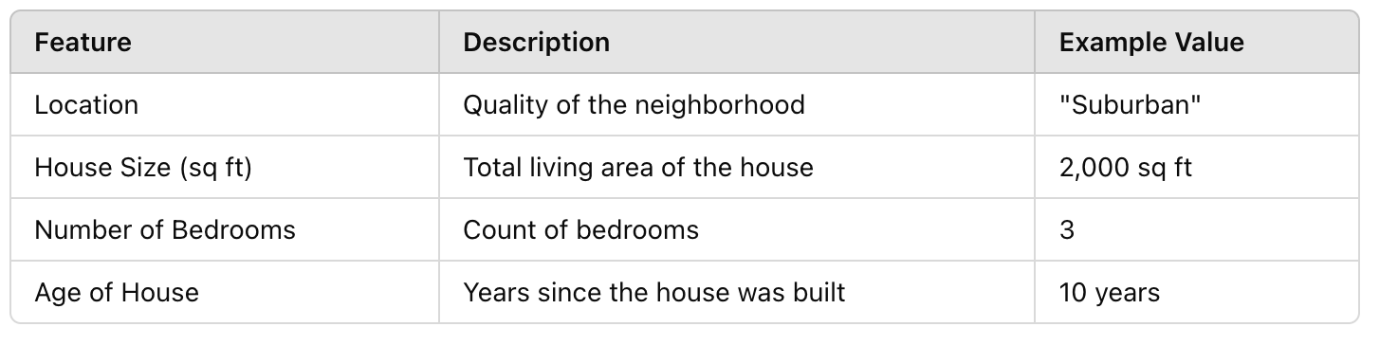
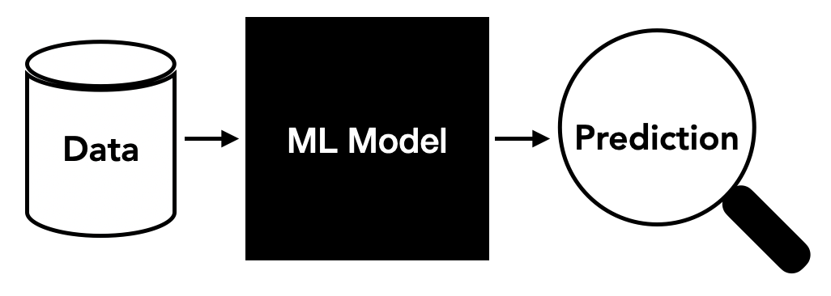
Housing Price Prediction

Slide 3
Housing Price Prediction
Accuracy: 80

Slide 4
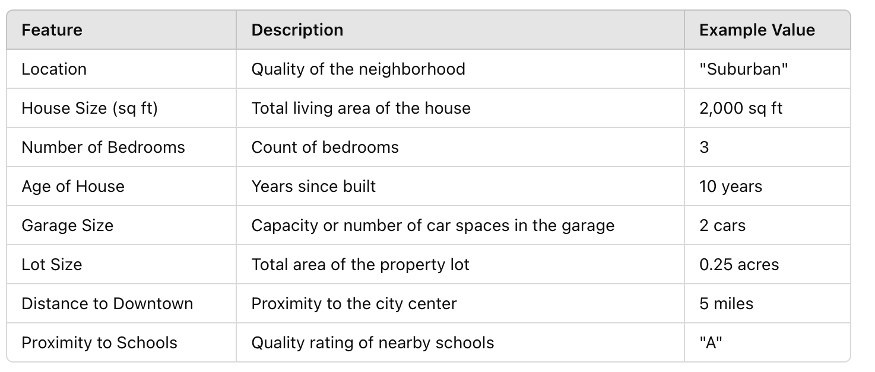
Housing Price Prediction
Accuracy: 60

Slide 5
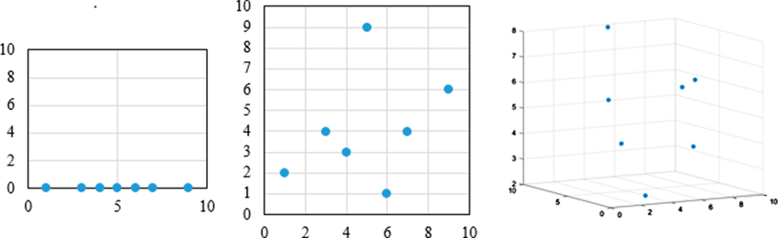
Housing Price Prediction
Curse of Dimensionality
Feature | Description | Example Value
Location | Quality of the neighborhood | "Suburban"
House Size (sq ft) | Total living area of the house | 2,000 sq ft
Number of Bedrooms | Count of bedrooms | 3
Age of House | Years since built | 10 years
Garage Size | Capacity of the garage | 2 cars
Lot Size | Total area of the property lot | 0.25 acres
Roof Type | Type of roofing material | "Asphalt Shingle"
Distance to Downtown | Miles from the city center | 5 miles
Proximity to Schools | Quality rating of nearby schools | "A"
Recent Renovations | Whether the house has been renovated recently | Yes/No
Air Quality Index | Local air quality measure | 45 (Good)
Noise Level | Average noise level in the area (decibels) | 55 dB
Number of Nearby Amenities | Count of nearby parks, restaurants, and malls | 10
Garden Area (sq ft) | Size of the garden | 500 sq ft
Swimming Pool | Presence of a swimming pool | Yes/No
Historical Price Trend | Indicator of past price trends in the neighborhood | "Upward Trend"
Interior Design Rating | A subjective rating of interior design quality | 8/10
Smart Home Features | Count of smart home features (e.g., thermostat, security) | 4
Number of Bathrooms | Count of bathrooms | 2
Energy Efficiency Rating | Efficiency rating of the home | "B+"
Accuracy: 40

Slide 6
Curse of Dimensionality
How to remove curse of dimensionality:
Feature selection: only consider the important features
Dimensionality Reduction: extract features.
f1, f2, f3, f4
D1, D2
Original set of features
Derived features
Notes:
Feature selection: we only take the important features,
Dimensionality Reduction: feature extraction

Slide 7


Feature Selection vs. Feature Extraction
Dimensionality reduction:
3D
2D
Notes:
Why dimensionality reduction?
Prevent curse of dimensionality
Improve the performance of the model
Visualize the data, understand the data

Slide 8
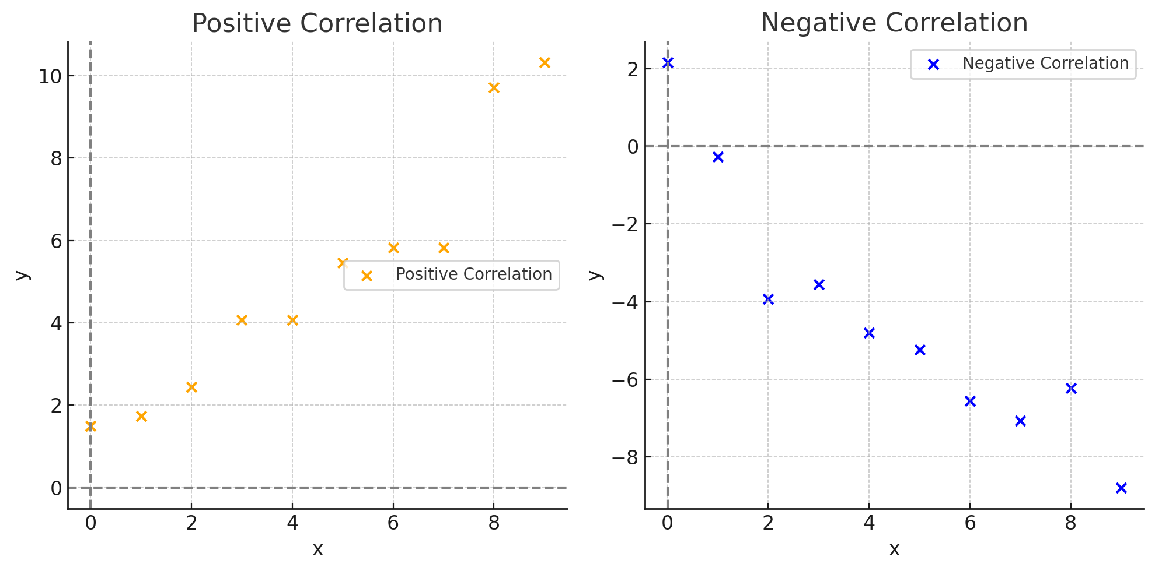
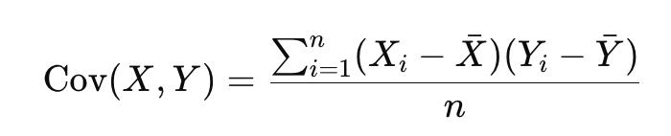
Feature Selection vs. Feature Extraction
x | y (Positive) | y (Negative)
0 | 0.2 | -0.3
1 | 1.8 | -1.1
2 | 2.9 | -2.2
3 | 3.5 | -2.8
4 | 4.2 | -4.1
5 | 5.3 | -5.4
6 | 6.1 | -6.2
7 | 7.8 | -7.0
8 | 8.5 | -8.3
9 | 9.6 | -9.2
X
Y
X
Y
-
+
X
Y
X
Y
Notes:
Positive Covariance: Indicates that as X increases, Y tends to increase.
Negative Covariance: Indicates that as X increases, Y tends to decrease.
Zero Covariance: Suggests no linear relationship between XXX and YYY.
If there is + positive covariance or high relationship, means, these features are important

Slide 9
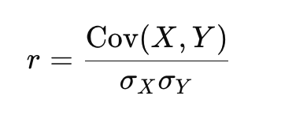
Feature Selection vs. Feature Extraction
x | y (Positive) | y (Negative)
0 | 0.2 | -0.3
1 | 1.8 | -1.1
2 | 2.9 | -2.2
3 | 3.5 | -2.8
4 | 4.2 | -4.1
5 | 5.3 | -5.4
6 | 6.1 | -6.2
7 | 7.8 | -7.0
8 | 8.5 | -8.3
9 | 9.6 | -9.2
X
Y
X
Y
-
+
X
Y
X
Y
Pearson correlation:
-1 to +1
Notes:
r=1: Perfect positive linear correlation.r=−1r = -1r=−1: Perfect negative linear correlation.r=0r = 0r=0: No linear correlation.

Slide 10
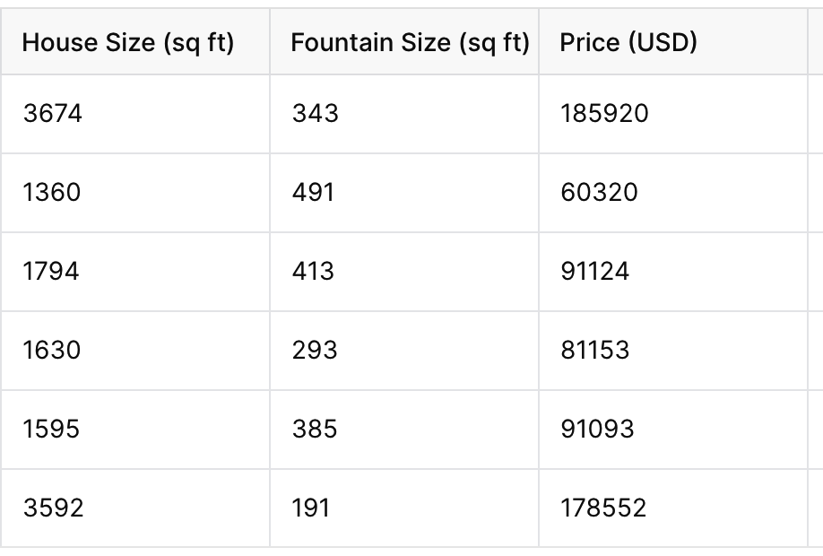
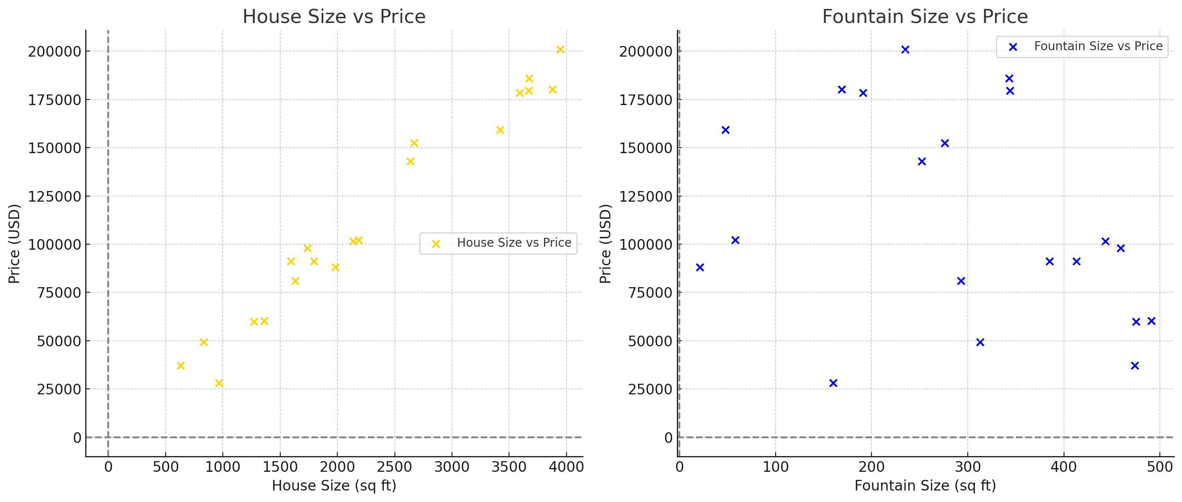
Feature selection
Notes:
House Size vs Price: Displays a strong positive linear relationship.
Fountain Size vs Price: Displays no significant correlation, with points spread out.

Slide 11
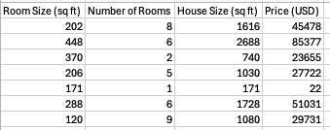
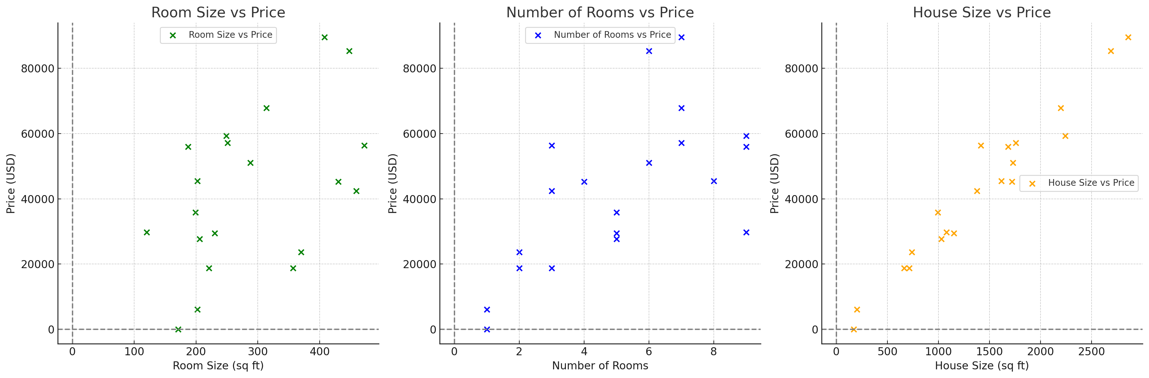
Feature Extraction
4D ➔ 2D

Slide 12
Principal Component Analysis (PCA)
PCA is a dimensionality reduction technique that transforms a high-dimensional dataset into a lower-dimensional space while preserving as much variance as possible.
Steps in PCA:
Standardize the data.
Compute the covariance matrix.
Perform eigen decomposition of the covariance matrix to get eigenvalues (variance) and eigenvectors (principal components).
Project the data onto the new principal component axes.

Slide 13
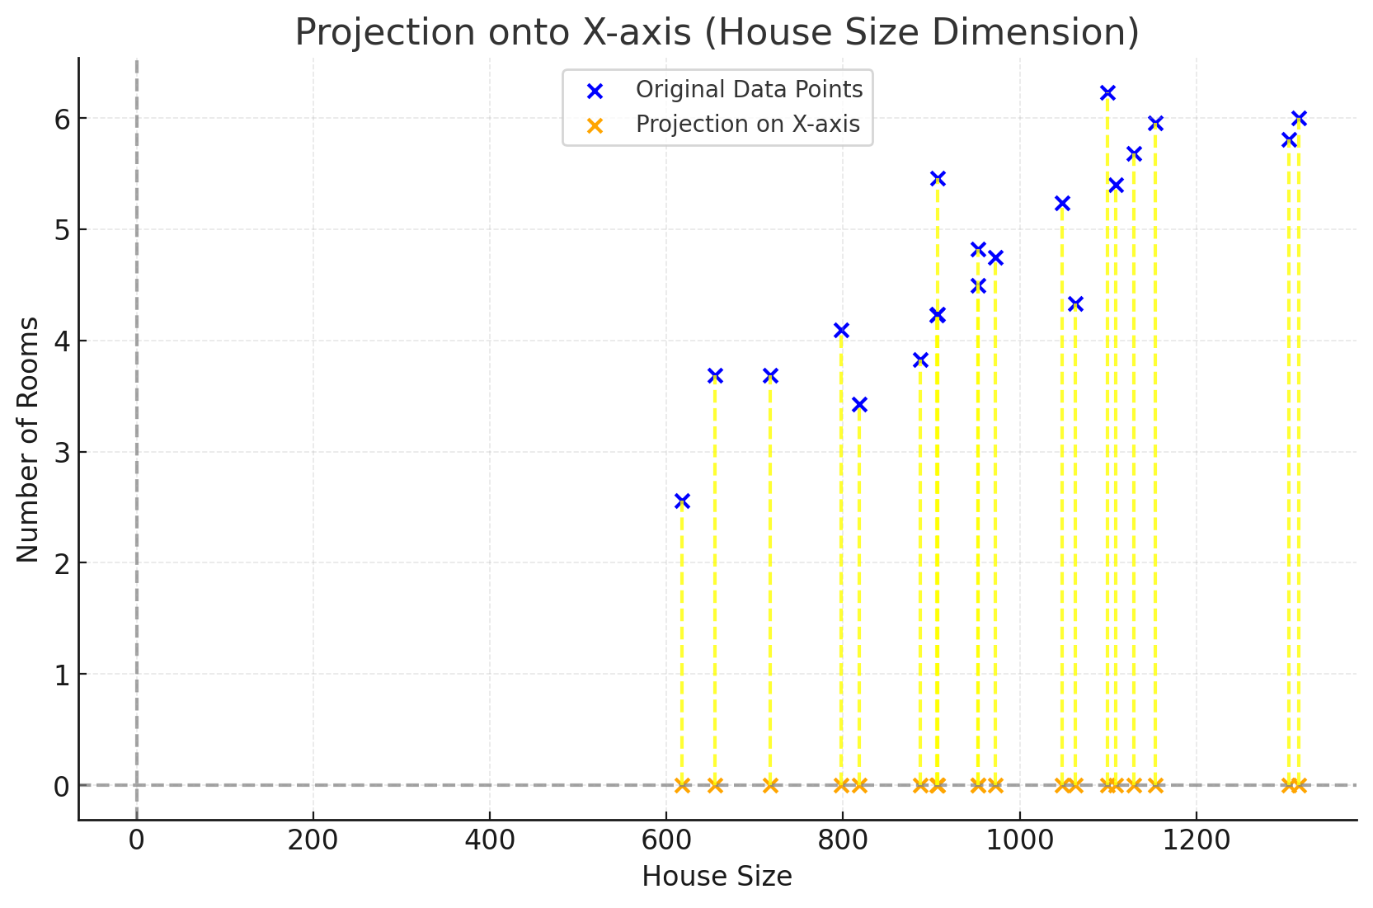
Dimensionality reduction
Loss of information
Notes:
Spread in the X-Direction (House Size):
The spread of the data along the House Size (x-axis) reflects the variance captured in this dimension.
The orange points on the x-axis indicate the projected values, showing that most of the variation in the data is retained in this direction.
This direction accounts for the primary differences in the dataset.
Spread in the Y-Direction (Number of Rooms):
The blue points have some variation in the Number of Rooms (y-axis), but it is relatively small compared to the x-axis.
When projecting the points to the x-axis, we are effectively neglecting the y-axis variance, assuming it contributes less to the dataset's overall variability.
Variance Explanation:
Variance measures how spread out the data is. The x-axis (House Size) has the most variance in the dataset, and thus projecting to this axis retains the most information.
The variance along the y-axis (Number of Rooms) is minimal, which justifies its exclusion during the projection.
Dimensionality Reduction Implication:
By reducing the data from 2D to 1D, we focus only on the primary source of variance (House Size).
While some minor details (variance along the y-axis) are lost, the major pattern in the data (spread along the x-axis) is preserved.

Slide 14
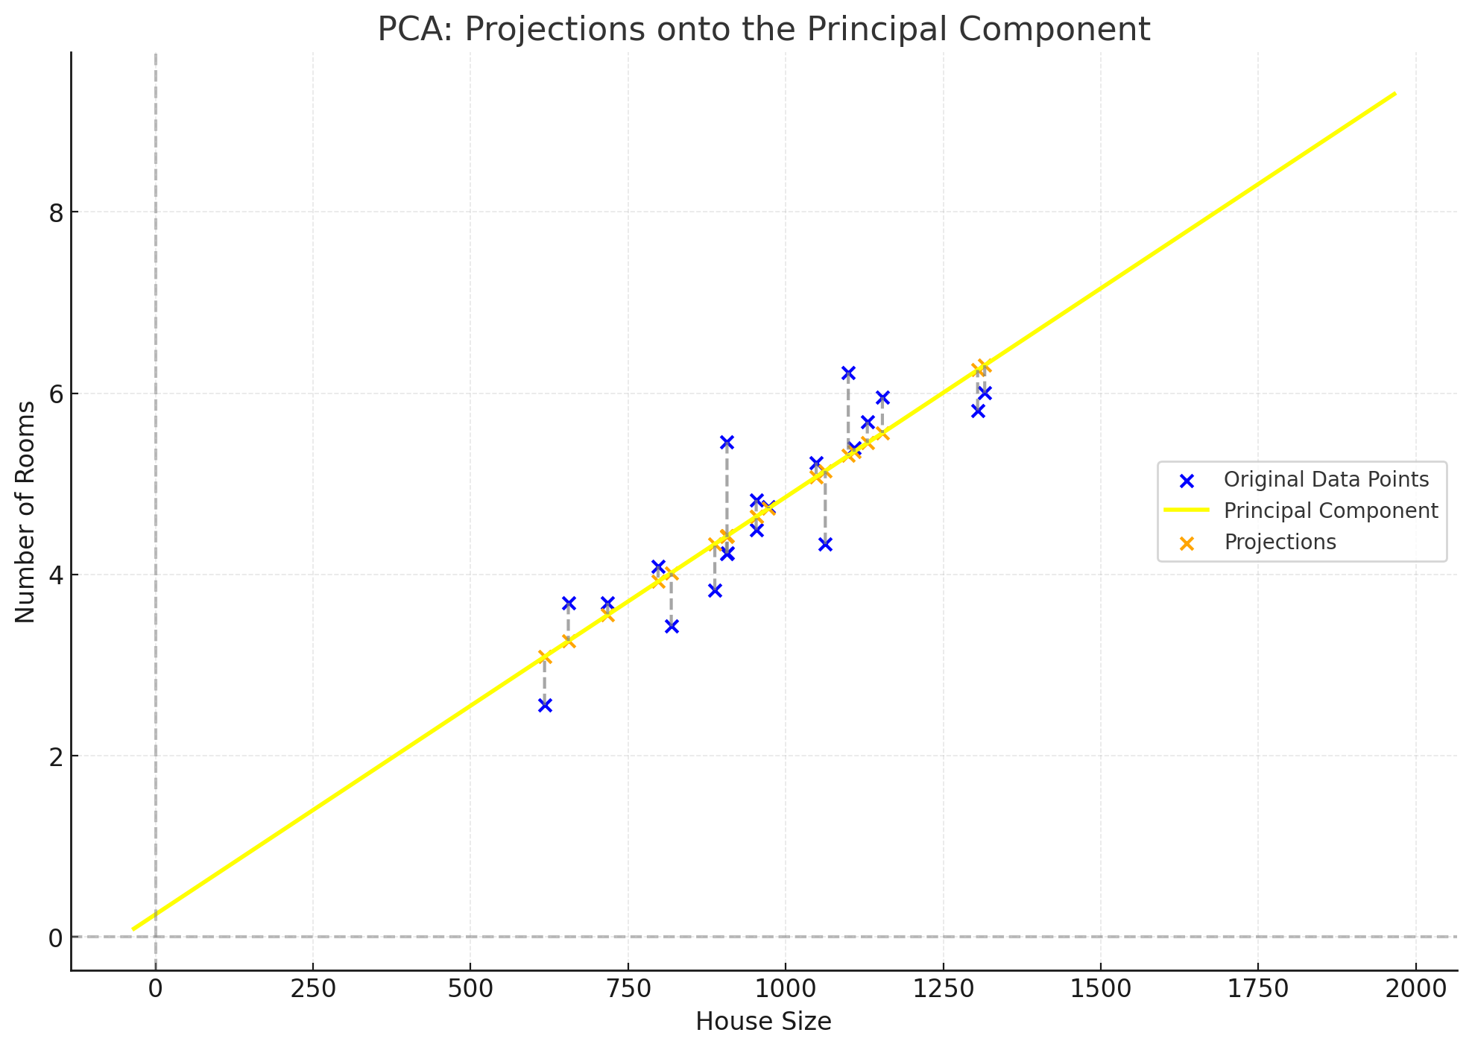
PCA
Notes:
Blue Points (Original Data):
Represent the original 2D data points with House Size on the x-axis and Number of Rooms on the y-axis.
Each point reflects a combination of these two features.
Yellow Line (Principal Component 1 - PC1):
This line is the direction of maximum variance in the data.
It passes through the mean of the data (marked by the intersection of projections) and shows the dominant trend in the data.
PC1 captures the most important relationship between House Size and Number of Rooms.
Orange Points (Projections on PC1):
The orange points are the projections of the original data onto the principal component.
These represent the data in the reduced dimension (1D), where only the most significant variance is retained.
Dimensionality Reduction:
The original data has two features: House Size and Number of Rooms, making it 2D.
Using Principal Component Analysis (PCA), we project all data points onto the principal component (PC1), which is a single dimension (1D) that captures the maximum variance.
By focusing on PC1, we ignore the smaller variance captured by PC2 (orthogonal to PC1), effectively reducing the data to 1D.
Projections onto PC1:
Each data point is projected onto PC1, resulting in a single coordinate along the principal component axis.
While the visualization still exists in 2D space for clarity, the information is reduced to a single value along PC1 (orange points).
Loss of Orthogonal Variance:
The variance in the direction orthogonal to PC1 (i.e., PC2) is not included in the reduced representation.
This simplification is what makes it 1D.
Why is it still displayed in 2D?
The visualization is shown in 2D for interpretability:
Blue Points: Represent the original 2D data.
Orange Points: Represent the 1D data projected onto PC1 for dimensionality reduction.
In reality, the 1D representation would only retain the distances along PC1, completely discarding any orthogonal variance. Let me know if you need further clarification!
The key differences between the two visualizations are:
Projection Direction:
Previous Visualization: Projects the data directly onto the x-axis (House Size), ignoring the actual relationship between features.
Current Visualization: Projects data onto the principal component (PC1), which is the direction of maximum variance, determined through PCA.
Variance Capture:
Previous Visualization: Does not account for the spread of data along a meaningful axis; it simply reduces dimensionality along the x-axis.
Current Visualization: Retains the most information by projecting onto PC1, preserving the largest variance in the data.
Accuracy of Representation:
Previous Visualization: Ignores any diagonal relationship between House Size and Number of Rooms.
Current Visualization: Accurately represents the data's structure by aligning with the dominant trend.
Principal Component Inclusion:
Previous Visualization: Does not involve PCA or eigen decomposition.
Current Visualization: Explicitly uses PCA to calculate PC1 and projects the data accordingly.
Why Is This Approach Better in Practice?
Maximizes Information Retention:
PCA ensures that the maximum amount of variance (or spread) in the data is preserved in the reduced dimension.
A simple projection to the x-axis may lose more information if the data is not aligned with the axis.
Data Relationships Are Clearer:
PCA-based projections respect the natural structure and relationships within the data, providing more meaningful insights.
Basis for Further Analysis:
This PCA visualization lays the groundwork for advanced analysis like clustering, regression, or classification in the reduced dimension.

Slide 15
Goal of the PCA: Finding the Best Line
Notes:
The goal is to get the best PCA line which can capture the max variance.
Projection
Cost function➔ variance

Slide 16
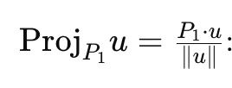
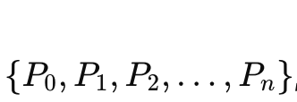
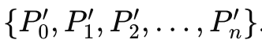
Step 1: Projection to Scalars
*
P(x₁ ,y₁)
u
*
*
*
*
*
*
y
P’
*
*
=
*
x
Notes:
ProjPi​​u=Pi​⋅u: The projection of a point PiP_iPi​ onto a vector uuu is calculated as the dot product of PiP_iPi​ and uuu.
This results in a scalar value, which represents the magnitude of the projection along uuu.
Collection of Scalars:
For multiple points {P0,P1,P2,…,Pn}, their projections onto u yield a set of scalar values {P0′,P1′,P2′,…,Pn′}
These scalars effectively represent the data in the reduced (1D) space along the vector uuu
Goal:
Find the unit vector (direction of projection) that maximizes the variance of the projected points.
This is the essence of PCA, where the first principal component captures the maximum variance.

Slide 17
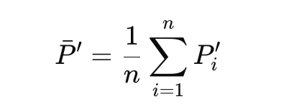
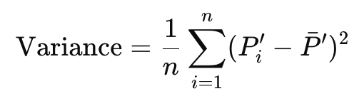
Step 2: Variance of Scalars
Mean of Scalars
Variance Formula: :
Cost function
Notes:
Variance measures the spread of these scalar values. For the scalars {P0′,P1′,…,Pn′}\{P_0', P_1', \dots, P_n'\}{P0′​,P1′​,…,Pn′​}:
Variance measures the spread of these scalar values. For the scalars {P0′,P1′,…,Pn′}\{P_0', P_1', \dots, P_n'\}{P0′​,P1′​,…,Pn′​}:
Mean of Scalars: Calculate the mean of the scalars:
Variance Formula: Calculate the variance of the scalars:
Variance=1n∑i=1n(Pi′−Pˉ′)2\text{Variance} = \frac{1}{n} \sum_{i=1}^n (P_i' - \bar{P}’)^2
This measures how much the scalars deviate from their mean. A higher variance indicates that the projection vector uuu captures more spread (or information) from the data.

Slide 18
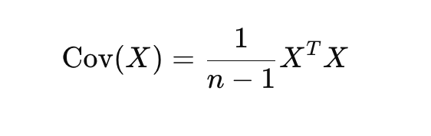
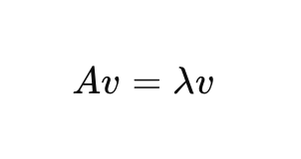
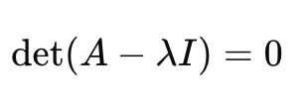
Step 3: Maximizing Variance
Eigen values and Eigen vectors:
Covariance Matrix
Eigenvectors and Eigenvalues
Selecting Principal Components
The eigenvector with the largest eigenvalue is the first principal component.
v=
Notes:
The goal of PCA is to find the unit vector u that maximizes the variance of the scalars
The covariance matrix represents the pairwise relationships (covariance) between features in the dataset. This matrix quantifies how features vary together.
Eigenvectors and eigenvalues are derived from the covariance matrix.The eigenvectors indicate the directions of maximum variance in the data.The eigenvalues represent the magnitude of variance along these directions.
X: The data matrix of size n×d(with n data points and d features).
X^T: The transpose of the data matrix.
n−1: The number of samples minus one (used for an unbiased estimate of covariance).
A: Covariance matrix.
v: Eigenvector (direction of variance).
λ\lambdaλ: Eigenvalue (magnitude of variance along vvv).
Eigenvectors represent directions (axes) in the data space.
Eigenvalues quantify the variance along these directions.
Subsequent principal components are orthogonal eigenvectors with decreasing eigenvalues.
Linear Transformation:
Eigenvectors are essential for transforming the dataset into a new coordinate system aligned with principal components.
This process maximizes variance in the reduced dimensions.
An eigenvalue λ\lambdaλ is a scalar that represents the amount of variance or the scaling factor associated with its corresponding eigenvector vvv.

Slide 19
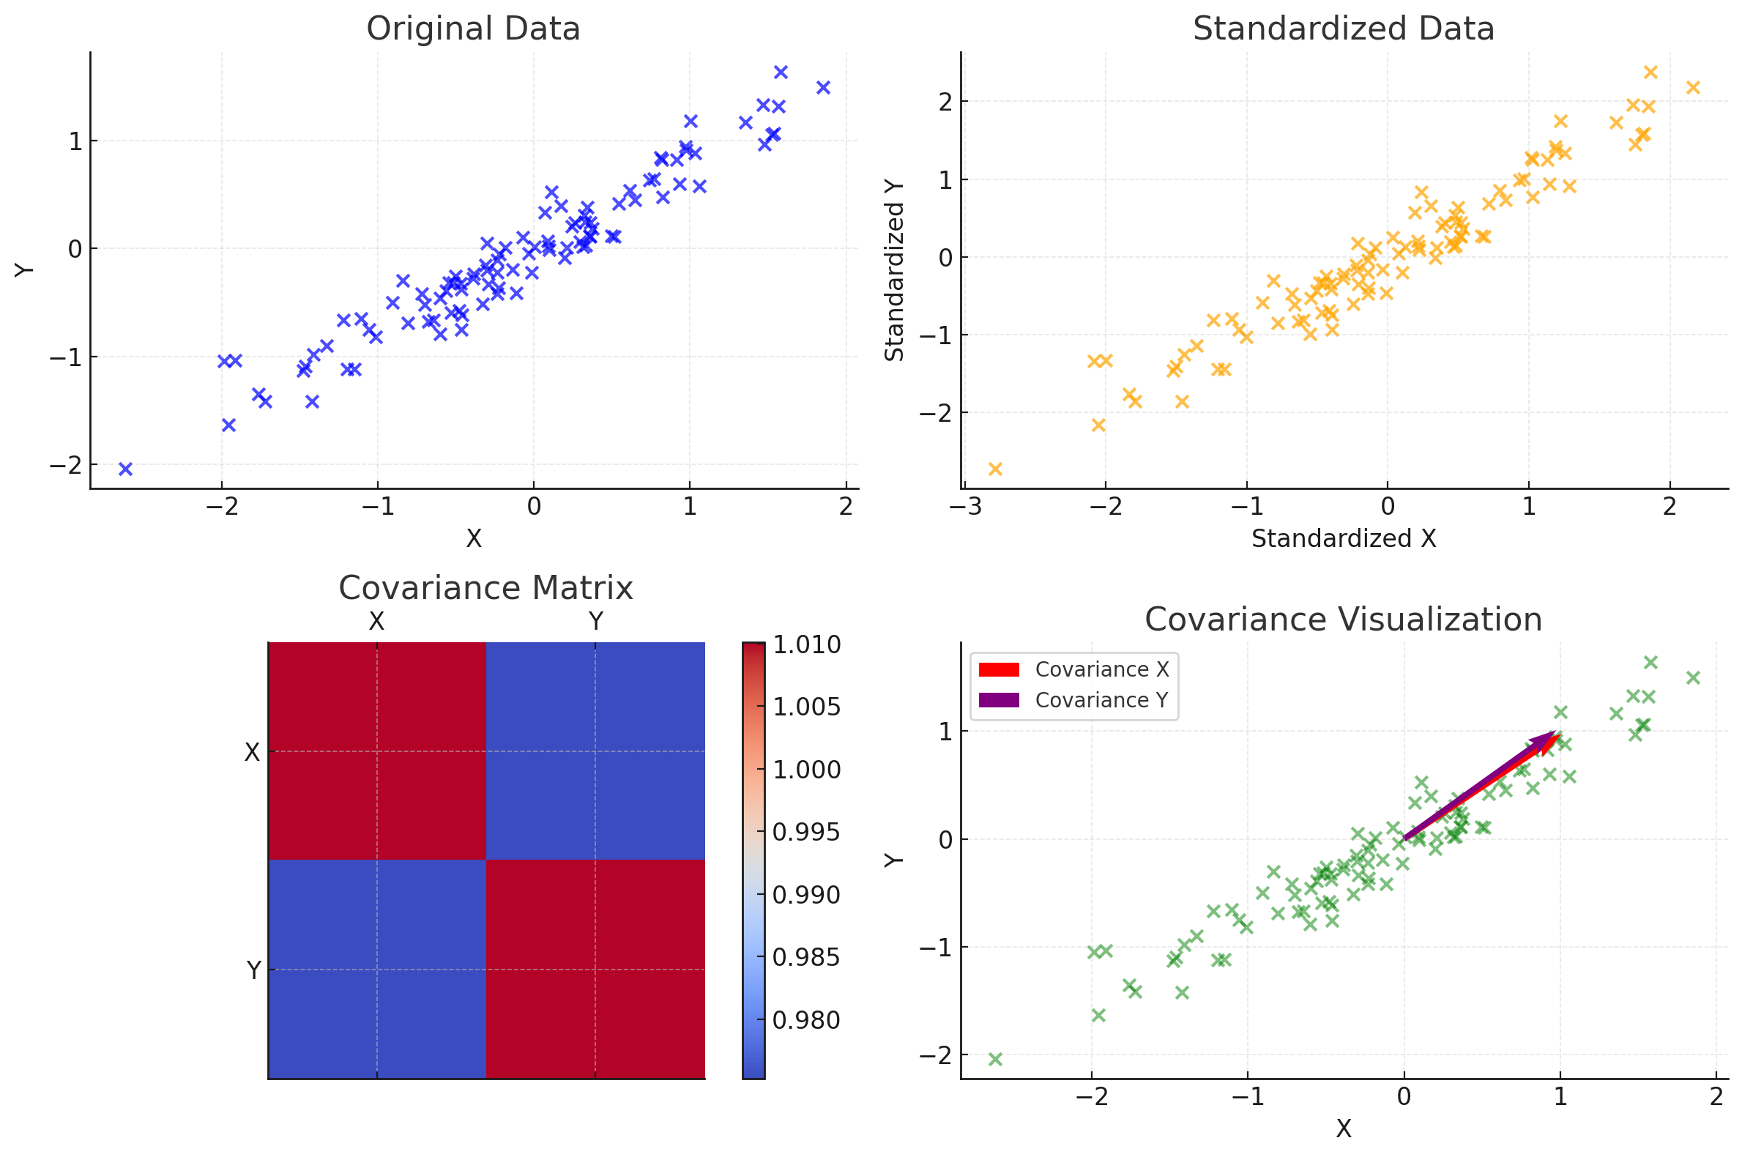
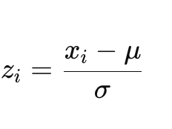
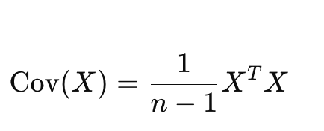
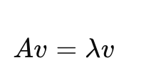
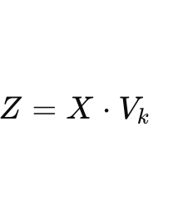
PCA
Standardized the data
Covariance Matrix
Perform Eigen Decomposition
Select Principal Components: choose the top k eigenvectors
Project Data onto Principal Components
Notes:
The data is first standardized to have a mean of 0 and a standard deviation of 1.This step ensures all features are on the same scale, preventing features with larger values from dominating the variance.
The covariance matrix summarizes the relationships (variance and covariance) between features.
Decompose the covariance matrix into eigenvectors and eigenvalues. This step finds the principal components.
Transform the original data into the new coordinate system defined by the selected principal components.
Equation:
Z=X⋅VkZ = X \cdot V_kZ=X⋅Vk​Where:
ZZZ: Transformed data.
XXX: Original standardized data matrix.
VkV_kVk​: Matrix of the top kkk eigenvectors.

